Slide 1
Portfolio Optimization Progress Report:
20/12/2024
TANG Jiarui | 21016753

Slide 2


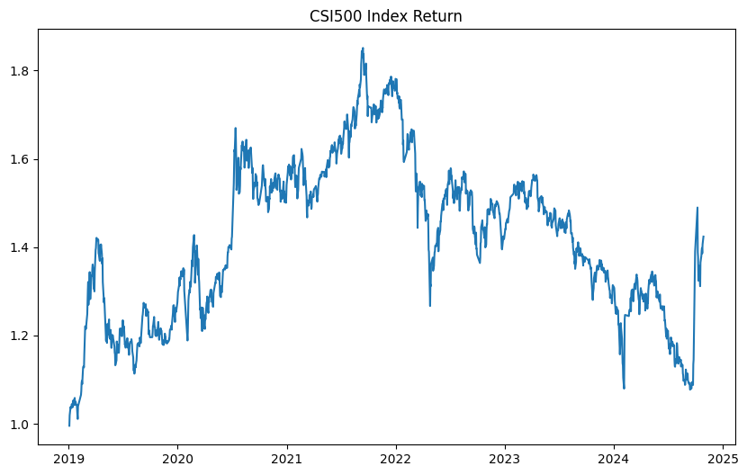
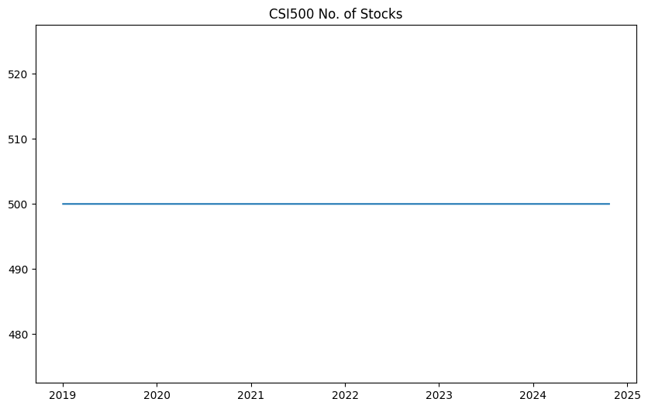
Sample
Overview
Optimization
Object
Backtest
Setting
Backtest
Results
Future plan
and Improvement
Sample Overview
CSI500
Sample Data
Index Performance
CSI 500 constituents
500 stocks each day
2019/01/01 – 2024/10/23
968 stocks covered

Slide 3
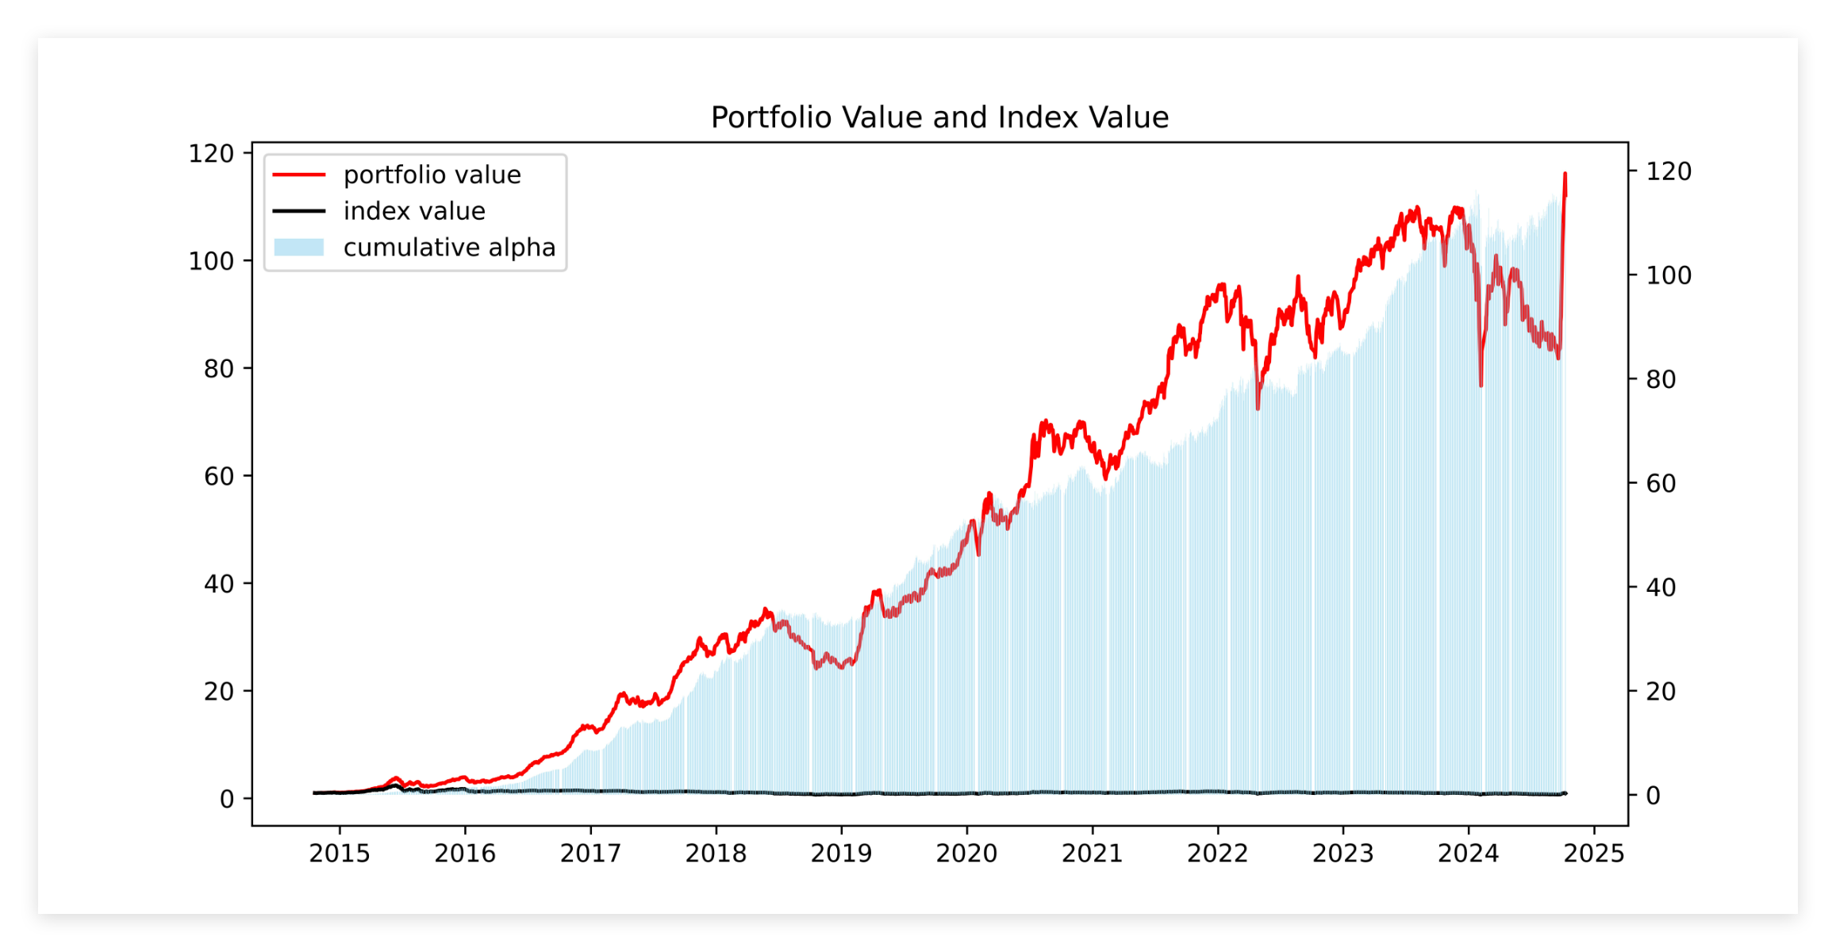
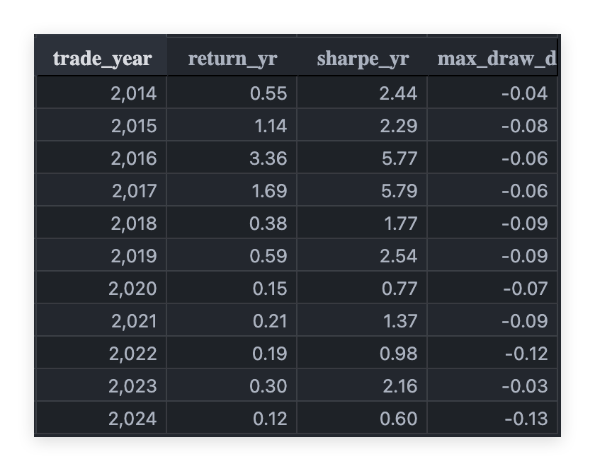
Sample
Overview
Optimization
Object
Backtest
Setting
Backtest
Results
Future plan
and Improvement
Backtest Results

Slide 4
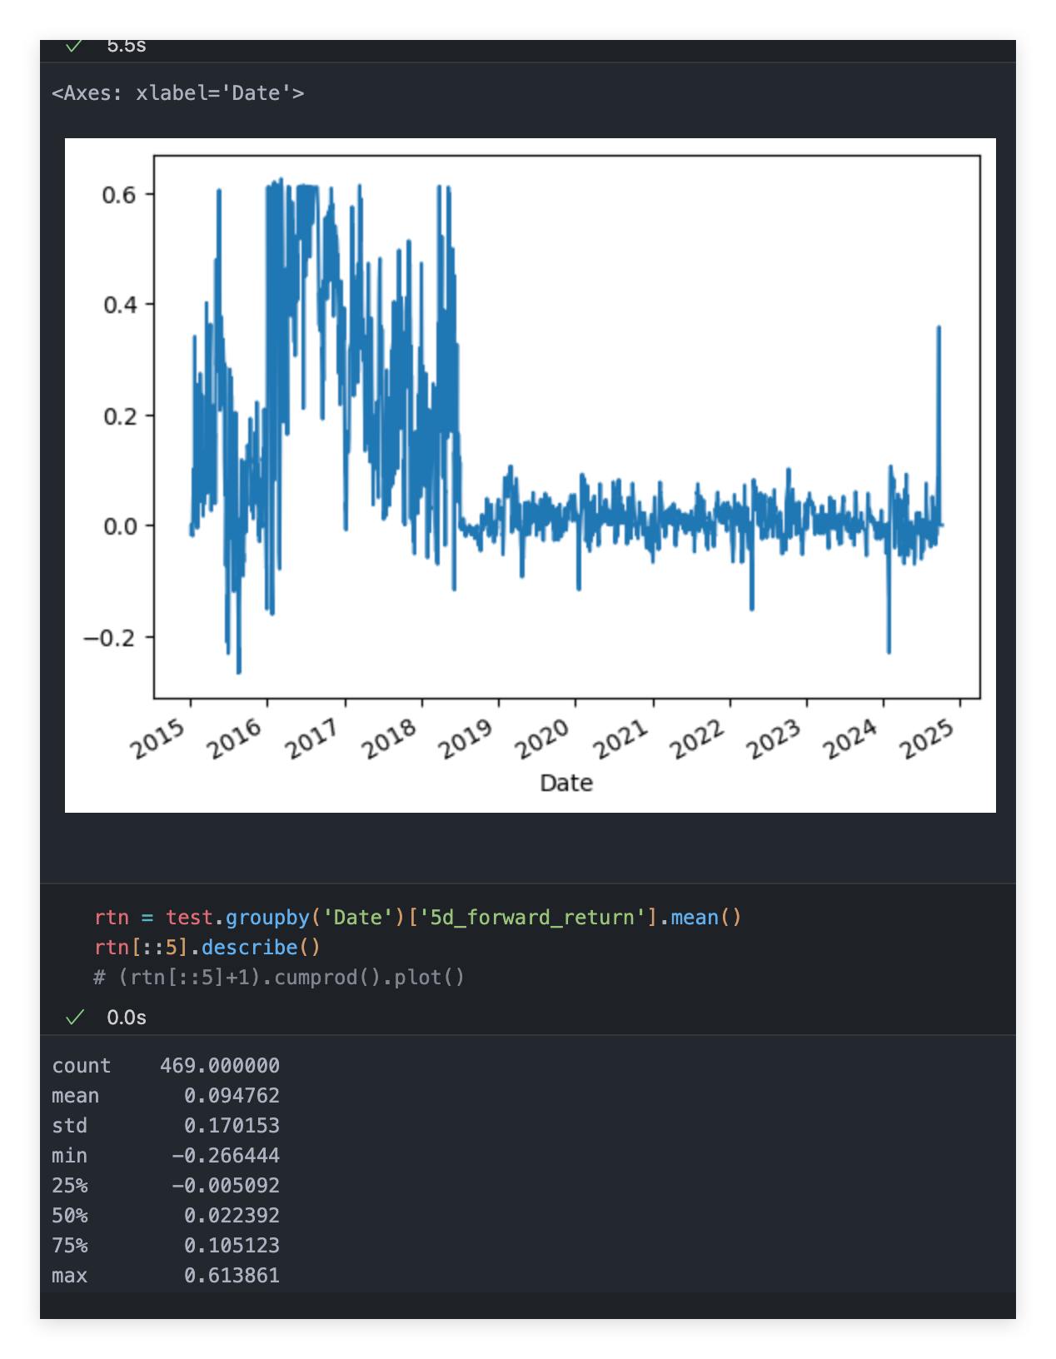
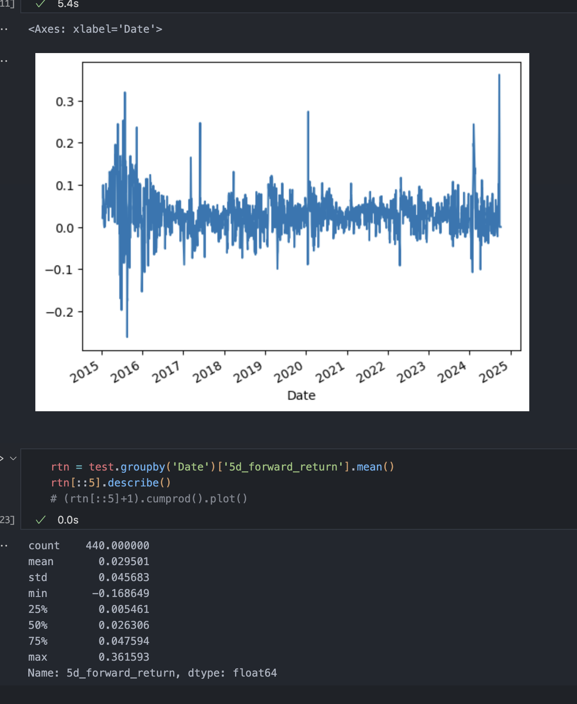
Sample
Overview
Optimization
Object
Backtest
Setting
Backtest
Results
Future plan
and Improvement
Backtest Results
Equally weigthed

Slide 5
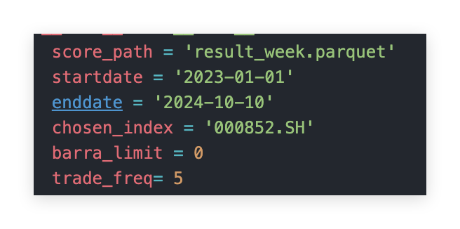
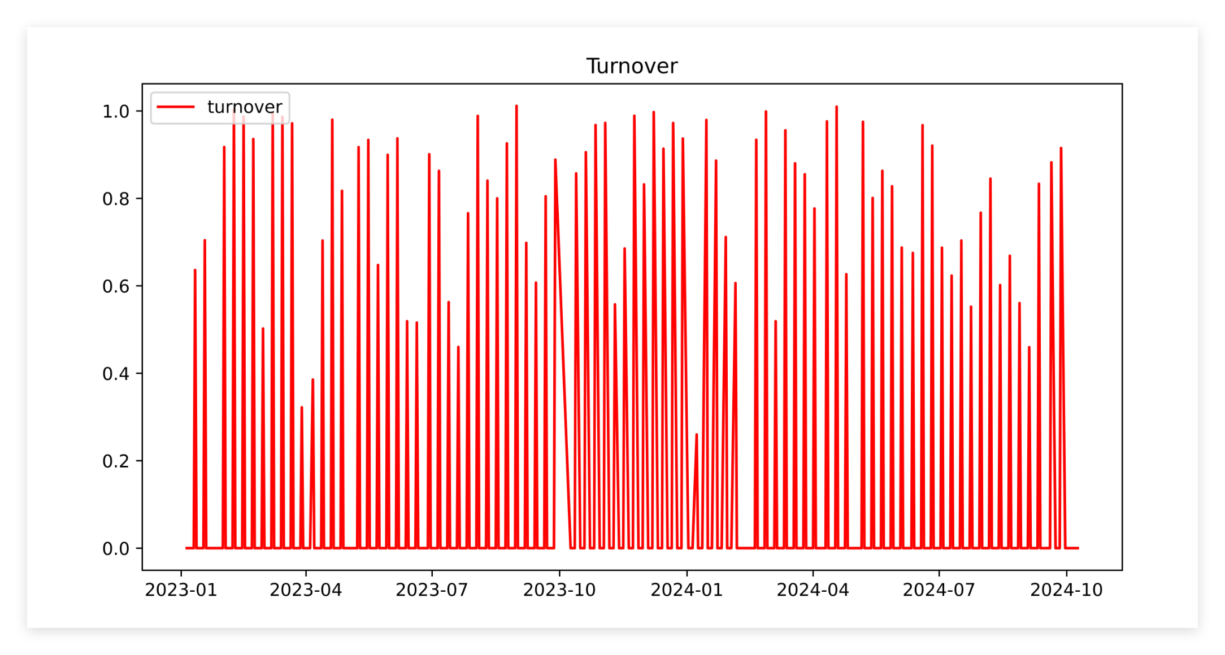
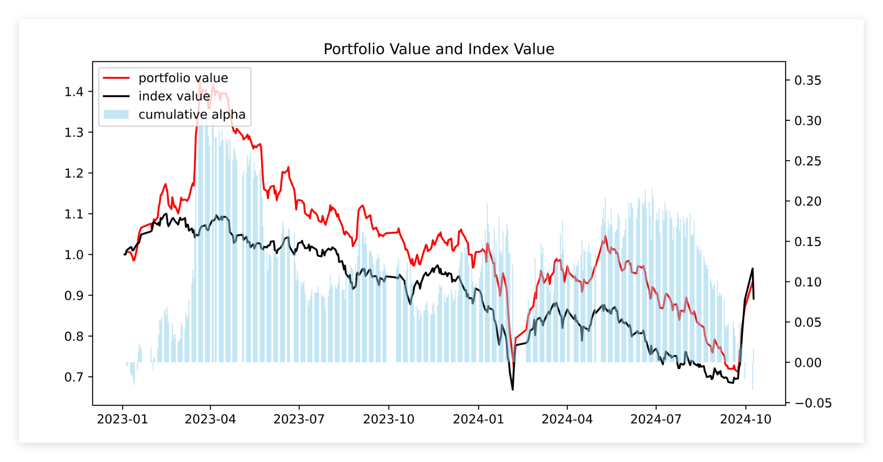
Sample
Overview
Optimization
Object
Backtest
Setting
Backtest
Results
Future plan
and Improvement
Backtest Results
Equally weigthed

Slide 6
Sample
Overview
Optimization
Object
Backtest
Setting
Backtest
Results
Future plan
and Improvement
Backtest Results
Barra exposure relative difference <=0.5

Slide 7
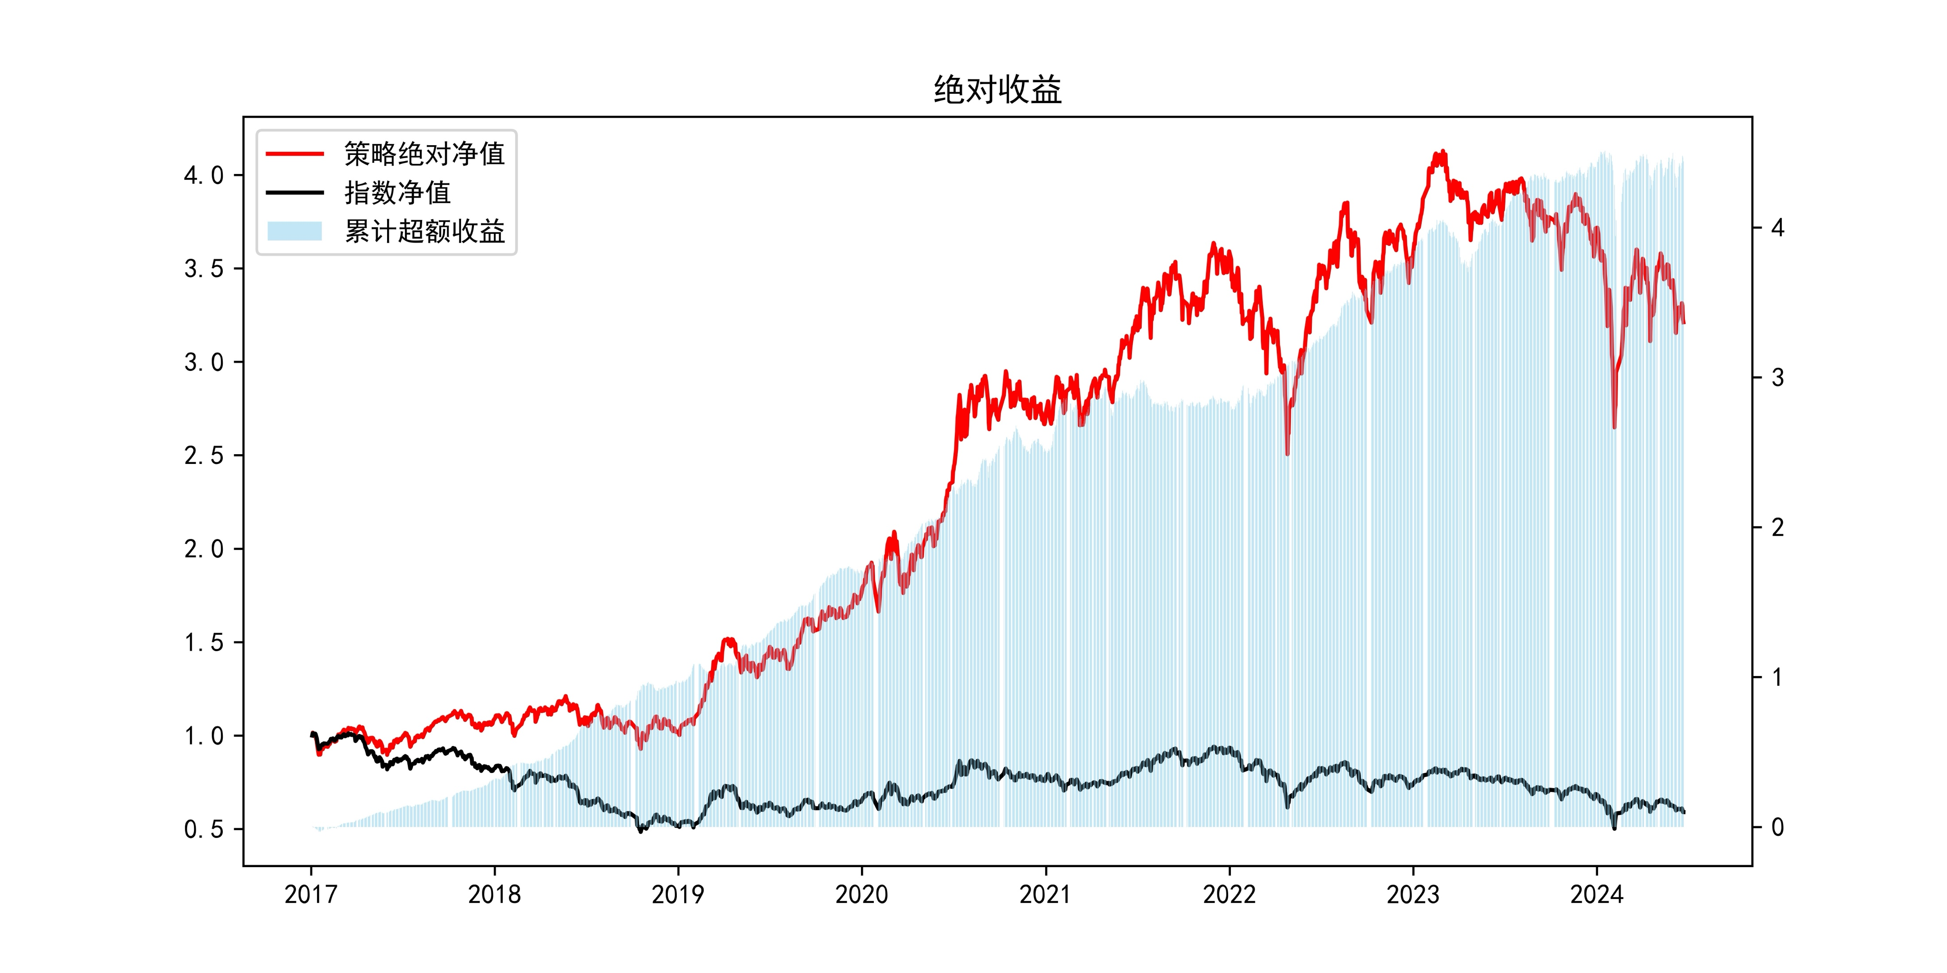
Sample
Overview
Optimization
Object
Backtest
Setting
Backtest
Results
Future plan
and Improvement
Backtest Results
Barra and industrial constraints effect on tracking error
Barra exposure relative difference <=0.7
turnover

Slide 8
Sample
Overview
Optimization
Object
Backtest
Setting
Backtest
Results
Future plan
and Improvement
Backtest Results
Apha and absolute value
300
500
1000

Slide 9
Sample
Overview
Optimization
Object
Backtest
Setting
Backtest
Results
Future plan
and Improvement
Backtest Results
Turnover
500
300
1000

Slide 10
Sample
Overview
Optimization
Object
Backtest
Setting
Backtest
Results
Future plan
and Improvement
Backtest Results
Turnover
300
500
1000

Slide 11
Sample
Overview
Optimization
Object
Backtest
Setting
Backtest
Results
Future plan
and Improvement
Plan Next Week
Test weekly and monthly traded
Apply Barra and industrial constraints (done, not test yet),
Adding trading costs to objective functions
Simulate stocks suspension

Slide 12
Thank you
TANG Jiarui 21016753

